Slide 1
Future Trends: Automation
14.02.2024

Slide 2
Robot process automation (RPA)
RPA is often associated with BOTs – software programs.
Low-code –> drag-and-drop
RPA tools allow users to design and deploy software robots that can mimic human actions
Tool that operates over another computer system in the same way a human would – Reduces repetition of manual work.
Automation of simple, predictable processes by applying rule-based procedure.
By deploying software robots, which emulate human processes, RPA tools complete the autonomous execution of various transactions and activities across unrelated software systems
Benefits of RPA
Downsides of RPA
productivity improvements
cost savings
does not require expensive and time consuming enterprise application integration efforts
bots need management and maintenance over their productive life
problems with original design – Password policies – bots can not access application

Slide 3
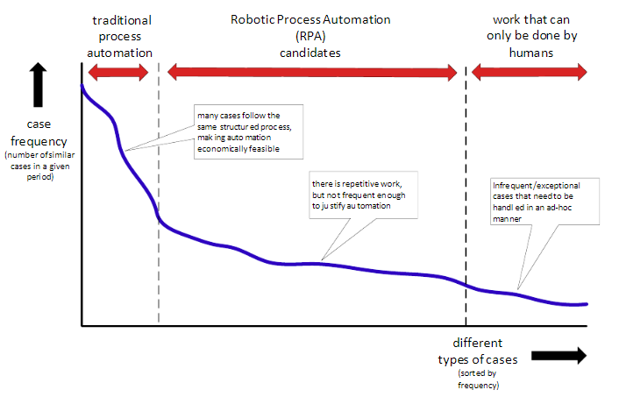

Slide 4
Examples
ERP Systems (with RPA-ERP integration. The bots will scan, validate, and digitize key data from the purchase orders and create invoices accordingly)
Web Scraping
Perform time-consuming actions of logging into applications
Moving files and folders
Copying and pasting data
Filling out forms
Extracting structured and semi-structured data from documents
Healthcare
Streamline customer interaction

Slide 5
